Slide 1
Workforce Development Spotlight: January 2022 A Summary of Upcoming Career Compass and WFD Opportunities
New Content Coming Your Way!
Live Webinars Coming This Month
Addressing Team Conflict in a Virtual Environment (Conflict Management; Awareness/Basic & Leaders managing remote teams) – 11 & 13 Jan
Challenging Conversations (Conflict Management; Intermediate) – 25 & 27 Jan
Details for both webinars: https://www.navfac.navy.mil/jobs/workforce-development/ccrc/emp_resources/comp_dev_content/conflict_mgmt.html
SYSCOM Training Opportunities
Please see the following page. The Career Compass Event Calendar has been updated to include all upcoming learning opportunities and trainings across SYSCOM. More details: https://www.navfac.navy.mil/jobs/workforce-development/ccrc/event-calendar.html
On-Demand Webinars and Resources Coming This Month
Conflict Management – All Levels (early Jan)
Infographic: Combating Common Sources of Conflict on Virtual Teams (Awareness/Basic)
On-Demand Webinar: Managing Conflict by Improving Emotional Intelligence (Intermediate)
Podcast: Cultivating Empathy at Work (Intermediate)
On-Demand Webinar: Coaching Through Conflict (Advanced/Expert)
Podcast: The Five Deep Sources of Conflict (Advanced/Expert)
White Paper: Leading Through Conflict (Advanced/Expert)
https://www.navfac.navy.mil/jobs/workforce-development/ccrc/emp_resources/comp_dev_content/conflict_mgmt.html
Accountability – Intermediate Level (early Jan)
On-Demand Webinar: Building an Accountability Framework
https://www.navfac.navy.mil/jobs/workforce-development/ccrc/emp_resources/comp_dev_content/accountability.html
For additional details, please talk to your local Civilian Training Advocate (BD17).
*Note: If you are unable to copy and paste the links above, QR codes are available on the following page.

Slide 2
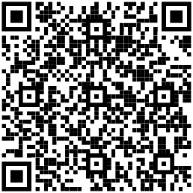
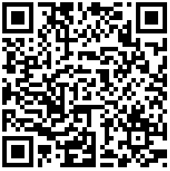
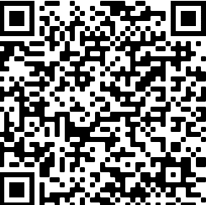
January SYSCOM Training Summary
The following QR codes can be used to access the pages referenced in the previous slide.
Start Date | Event
Mon, 10 Jan | Supervisor Academy’s New Supervisor Workshop: Cadre I (West Coast)
Tue, 11 Jan | Live Webinar: Addressing Team Conflict in a Virtual Environment
Thu, 13 Jan | Live Webinar: Addressing Team Conflict in a Virtual Environment
Tue, 25 Jan | Live Webinar: Challenging Conversations
Thu, 27 Jan | Live Webinar: Challenging Conversations
Conflict Management Competency Page
Career Compass Event Calendar
February Courses Open for Registration
Start Date | Event | Registration Deadline
Mon, 14 Feb | Supervisor Academy’s Current Supervisor Training Cadre 2 (West) | Fri, 11 Feb
Mon, 28 Feb | Supervisor Academy’s New Supervisor Workshop Cadre 2 (East) | Fri, 25 Feb
Accountability Competency Page

